Slide 1
Database MySQL
Universitas Muhammadiyah Surakarta
Yogiek Indra Kurniawan

Slide 2
All Files Can Be Downloaded In : http://yogiek.com Menu : “Perkuliahan”

Slide 3
MySQL
Free and Open Source
Easy To Use

Slide 4
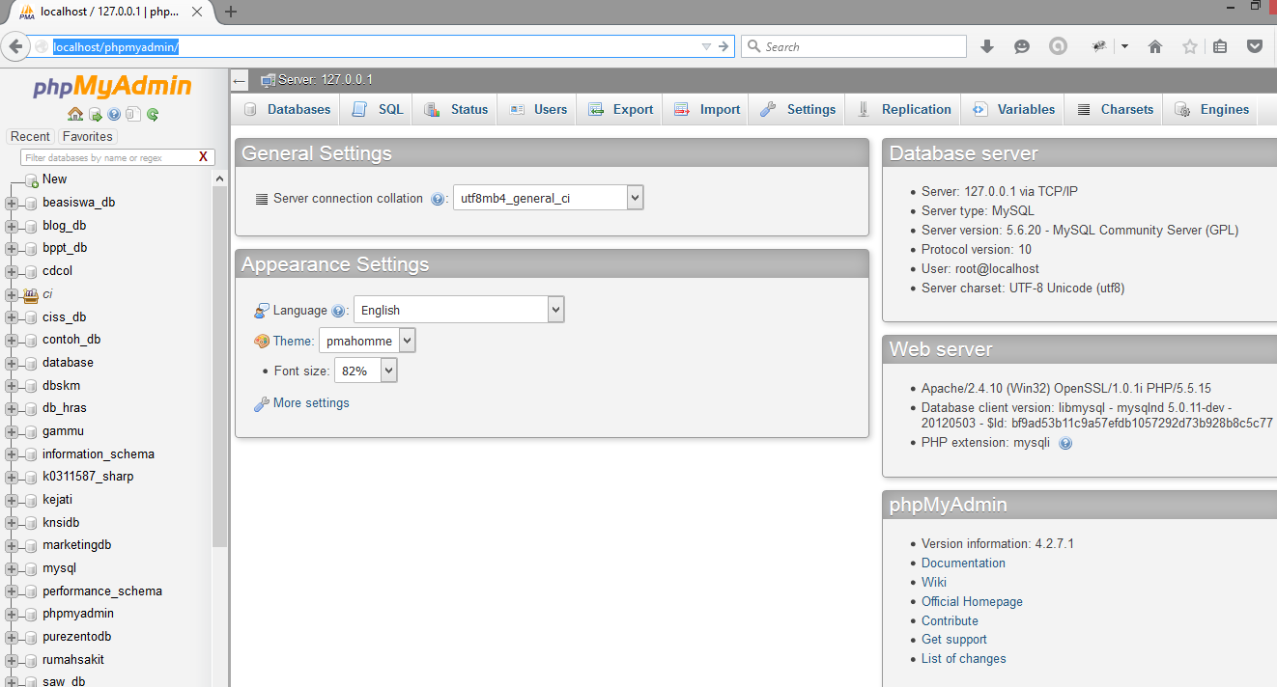

Slide 5
Data Definition Language (DDL)
Create
Alter
Drop
Rename

Slide 6
Data Manipulation Language (DML)
Insert
Update
Delete
Select

Slide 7

Web Application With Database

Slide 8
Step By Step To Build Web Application
Create Database, Table ( and Data)
Create File Connection (Select Database)
Create Query

Slide 9
File Connection
Setting DB server : Server, Username, Password
mysql_connect(‘nama_server’, ‘mysql_user’, ‘mysql_pass’);
<?php
$connect= mysql_connect(‘localhost’,’root’,’pass’);
if($connect){
echo “Connection Success”;
}else { echo “Connection Fail”;}
?>

Slide 10
File Connection
Setting / Select Database
mysql_select_db(‘database_name’);
<?php
$select_db= mysql_select_db(‘project’);
if($select_db){
echo “Database Success”;
}else { echo “Database Fail”;}
?>

Slide 11
Connect.php
<?php
$host = 'localhost';
$user = 'root';
$password = '';
$db = 'yogiek_db';
mysql_connect($host,$user,$password) or die ("Tidak Terhubung Ke Server Database");
mysql_select_db($db) or die ("Tidak Terhubung Ke Database");
?>

Slide 12
DML - Insert
Code to Execute Query
mysql_query(‘your_query’);
<?php
$sql = “insert into mahasiswa(nim,nama) values(‘123’,’Yogiek’)”;
$query = mysql_query($sql);
if($query){
echo “Query Success”;
}else { echo “Query Fail”;}
?>

Slide 13
DML - Update
Code to Execute Query
mysql_query(‘your_query’);
<?php
$sql = “update mahasiswa set nama=‘Yogiek Indra’ where nim=‘123’”;
$query = mysql_query($sql);
if($query){
echo “Query Success”;
}else { echo “Query Fail”;}
?>

Slide 14
DML - Delete
Code to Execute Query
mysql_query(‘your_query’);
<?php
$sql = “delete from mahasiswa where nim=‘123’”;
$query = mysql_query($sql);
if($query){
echo “Query Success”;
}else { echo “Query Fail”;}
?>

Slide 15
DML - Select
Code to Execute Query
while(mysql_fetch_array(mysql_query(“Your_Query”))){
//Your_Action
}
<?php
$sql = “select * from mahasiswa where nim=‘123’”;
$query = mysql_query($sql);
While ($row=mysql_fetch_array($query)){
echo “$row[‘nim’] $row[‘nama’]”;
}
?>

